Slide 1
Planning
Chapter 5
Notes:
Everyone plans to some extent, but the scope of planning activities varies among people involved
A Web engineer
day-to-day work—planning,
monitoring, and
controlling technical tasks.
A team leader plans,
monitors, and coordinates the combined work of a WebE team.
Other stakeholders
have little interest in the details of the planning activity,
but are very interested in the outcome.
WebApp increments are delivered over a time span that rarely exceeds 6 weeks
“Do we really need to spend time planning a WebApp effort?
If the WebApp increment is simple functions are straightforward),
planning will take very little time.
If the increment is complex in planning will require greater effort
Regardless of the characteristics of the increment, you must plan.

Slide 2
During Communication Activity We defined Scope
Scope is defined by answering the following questions:
Context. How does the WebApp fit into a business context, and what constraints are imposed as a result of the context?
Information objectives. What customer-visible content objects are used and produced by the WebApp increment?
Functionality. What functions are initiated by the end user or invoked internally by the WebApp to meet the requirements defi ned in usage scenarios?
Constraints and performance. What technical and environmental constraints will impact the framework activities that follow? What special performance issues will require design and construction effort?

Slide 3
All communication work products are relevant to the planning activity.
Statement describing business motivation for the overall WebApp
Statement of overall objective for the WebApp
List of user categories
List of informational goals for the WebApp increment to be planned
List of applicative (functional) goals for the WebApp increment to be planned
Description of the increment (the statement of scope)
List of content objects for the increment
List of functions for the increment
Set of usage scenarios that describe how each user category will interact with the increment
Notes:
it’s not necessarily sufficient for the planning activity.
Sometimes elaboration is needed
You May
proceed with planning and worry about the elaboration during the modeling activity,
do a bit of elaboration now, so that planning can be more reliable,
Do a complete elaboration to be sure you really understand this increment.

Slide 4
What If Gaps Still Exist in Your Understanding?
You’ll have to accept the fact that things remain a bit uncertain,—it’s one of the risks inherent in all engineering work.
You’ll have to complete the planning activity with imperfect information and move on.

Slide 5
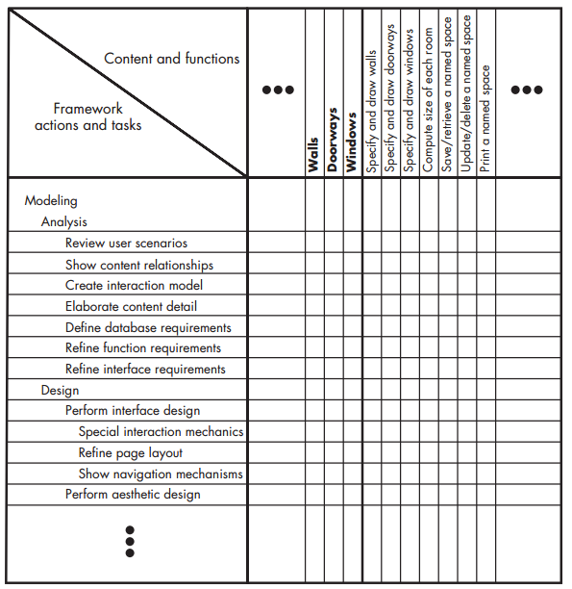
What Actions and Tasks Are Required?
create a task table for
Scenario
Develop a layout of the space to be monitored. [page 72]

Slide 6
What Work Products Will Be Produced?
intermediate work products
modeling representations,
interface sketches,
navigation maps
should be kept to the minimum that is necessary to provide appropriate guidance for the next framework action or task

Slide 7
What Is the Appropriate Way to Assess Quality?
If a WebE team stresses quality in all framework activities, the team reduces the amount of rework that it must do
You must explicitly define meaning of “WebApp quality” and define a set of tasks that will help ensure high quality
WebApp quality
completeness and accuracy of the problem definition,
the commodity of the solution design,
the firmness of construction, and
the overall degree of satisfaction to which the WebApp increment meets the needs of all stakeholders
Notes:
pair programming
Team walkthrough

Slide 8
Why Don’t Teams Jell and What Can Be Done to Help?
frenzied work atmosphere in which team members waste energy and lose focus on the objectives of the work to be performed.
High frustration caused by personal, business, or technological factors that causes friction among team members.
“Fragmented or poorly coordinated procedures” or a poorly defined or improperly chosen process model that becomes a roadblock to accomplishment.
Unclear definition of roles resulting in a lack of accountability and resultant finger-pointing.
“Continuous and repeated exposure to failure” that leads to a loss of confidence and a lowering of morale.

Slide 9
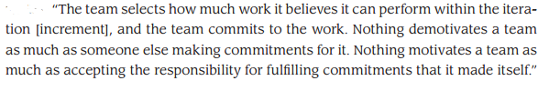
Building a webE team

Slide 10
WebE teams should be self-organizing
A self-organizing team has access to all information required to do the job, thereby avoiding a frenzied work environment in
A self-organizing team has control over
the process that is employed,
the work products that are produced,
the work schedule that is defined, and
the quality and change management activities that are implemented.
Therefore, the team avoids the frustration that occurs when there is a lack of control.

Slide 11
WebE teams should be self-organizing
A self organizing team establishes its own mechanisms for accountability and defines a series of corrective approaches when a member of the team fails to perform.
Every WebE team experiences small failures. The key to avoiding an atmosphere of failure is to establish team-based techniques for feedback and problem solving.
failure by any member of the team must be viewed as a failure by the team itself. This leads to a team-oriented approach to corrective action, rather than the finger-pointing and mistrust that grows rapidly on toxic team

Slide 12
How can a team manage itself
A team leader should be appointed to coordinate communication and work tasks
assess progress and problems by conducting daily team meetings (15 to 20 minutes) to coordinate and synchronize the work that must be accomplished for that day.
These brief meetings address four key questions:
What have we accomplished since the last meeting?
What needs to be accomplished before the next meeting?
How will each team member contribute to accomplishing what needs to be done?
What roadblocks exist that have to be overcome?

Slide 13
How Do We Build a Successful Team?
A set of team guidelines should be established
Strong leadership is a must.
Respect for individual talents is critical.
Every member of the team should commit.
It’s easy to get started, but it’s very hard to sustain momentum.
Notes:
A set of team guidelines should be established. These encompass what is expected of each person, how problems are to be dealt with, and what mechanisms exist for improving the effectiveness of the team as the project proceeds.
Strong leadership is a must. The team leader must lead by example and by contact and must exhibit a level of enthusiasm that gets other team members to “sign up” psychologically for the work that confronts them.
Respect for individual talents is critical. Not everyone is good at everything. The best teams make use of individual strengths. The best team leaders allow individuals the freedom to run with a good idea.
Every member of the team should commit. The main protagonist in Kidder’s book calls this “signing up.”
It’s easy to get started, but it’s very hard to sustain momentum. The best teams never let an “insurmountable” problem stop them. Team members develop a “good enough” solution and proceed, hoping that the momentum of forward progress may lead to an even better solution later in the project.

Slide 14
Characteristics of a Good Team Leader
Motivation. The ability to encourage technical people to produce to their best ability. This can be accomplished by providing incentives for high performance and imposing consequences for poor performance.
Organization. The ability to mold existing processes (or invent new ones) that will enable the initial concept to be translated into a final product.
Ideas or innovation. The ability to encourage people to create and feel creative even when they must work within bounds established for a particular WebApp
Notes:
Motivation. The ability to encourage technical people to produce to their best ability. This can be accomplished by providing incentives for high performance and imposing consequences for poor performance.
Organization. The ability to mold existing processes (or invent new ones) that will enable the initial concept to be translated into a final product.
Ideas or innovation. The ability to encourage people to create and feel creative even when they must work within bounds established for a particular WebApp

Slide 15
Managing Risk
people risks
directly traced to some human action or failing
product risks
can normally be traced to potential problems associated with WebApp content, functions, constraints, or performance
process risks
problems that are tied to the framework actions and tasks that have been chosen by the team
Notes:
people risks
but the team currently has no one with XML experience (technology related)
a specific stakeholder has been uncooperative when information is requested (communication related)
product risks
risk that could impact the tight delivery time of the increment is discovered only after construction has commenced
A major content object is outdated and may require substantial modification
process risks
too much process
work associated with developing a complete analysis model may be too time consuming and will cause a delay in design and construction activities.

Slide 16
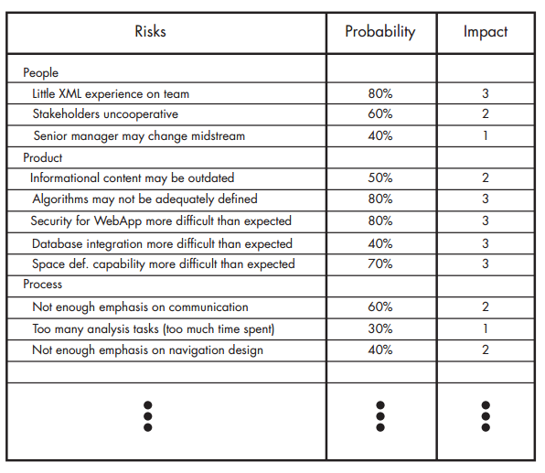
Risk Evaluation
the likelihood or probability that the risk will become a reality,
the consequences of the problems associated with the risk

Slide 17
Contingency Plans
How can we avoid the risk altogether?
What factors can we monitor to determine whether the risk is becoming more or less likely?
Should the risk become a reality, what are we going to do about it?

Slide 18
Developing Schedule
WebApp project scheduling is an activity that allocates the estimated effort for specific WebE tasks across the planned time line (duration) for building an increment
A Macroscopic schedule
Incremental schedule.

Slide 19
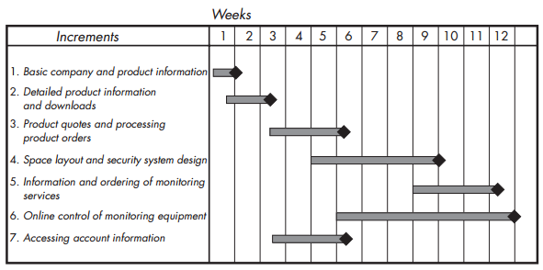
Macroscopic Schedule
identifies all WebApp increments and projects the dates on which each will be deployed

Slide 20
Incremental Scheduling
Expand each task into fine grained tasks.
Design the interface
Develop a sketch of the page layout for the space design page.
Review the layout with stakeholders.
Design the space layout navigation mechanisms.
Design the “drawing board” layout
Develop procedural details for the graphical wall layout function.
Develop procedural details for the wall length computation and display function.
Develop procedural details for the graphical window layout function.
Develop procedural details for the graphical door layout function.
Design mechanisms for selecting security system components (sensors, cameras, microphones, etc.).
Develop procedural details for the graphical layout of security system components.
Conduct pair walkthroughs as required

Slide 21
Estimating Effort and time
usage scenario–based estimation
Examining the team’s past history,
establish a value E_{avg}, the average effort (in person-days) required to deploy a usage scenario
Roughly Calculate the complexity of the scenario

Slide 22
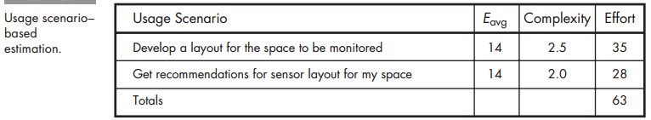
Estimating Effort and time

Slide 23
Estimating Effort and time
Product-process table
all major WebE actions are listed in the first column of the table.
All major content objects and functions for an increment are listed in the first row.
Team members estimate the amount of effort (in person-days) required to perform the WebE action for each content object and function.

Slide 24
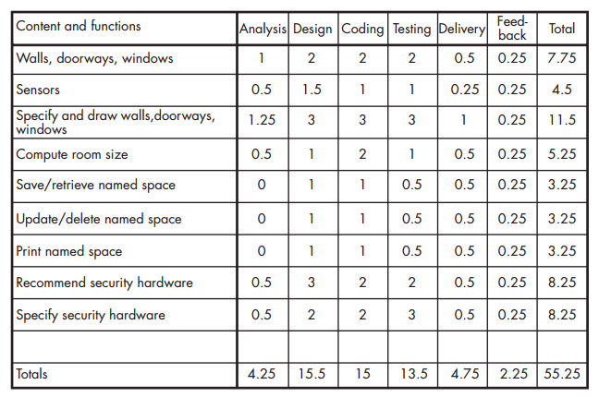
Estimating Effort and time

Slide 25
Managing Quality

